Slide 1

PPT模板示例
Steven Sun

Slide 2
PPT模板示例
Page 1 (Full-page Text)
Page 2 (Columns)
Page 3 (Image Hawaii)

Slide 3


Page 1 (Full-page Text)
Four score and seven years ago our fathers brought forth on this continent, a new nation, conceived in Liberty, and dedicated to the proposition that all men are created equal.
Now we are engaged in a great civil war, testing whether that nation, or any nation so conceived and so dedicated, can long endure. We are met on a great battle-field of that war. We have come to dedicate a portion of that field, as a final resting place for those who here gave their lives that that nation might live. It is altogether fitting and proper that we should do this.

Slide 4
Page 2 (Columns)
Membrane clam culture is the mainland of China on behalf of the third generation of the Communist Party of China's leadership, the former Central Committee General Secretary Jiang Zemin's words and deeds to imitate the network model, "film" to "worship" means, and "clams" Since that Jiang Zemin looks like toad view.

Slide 5
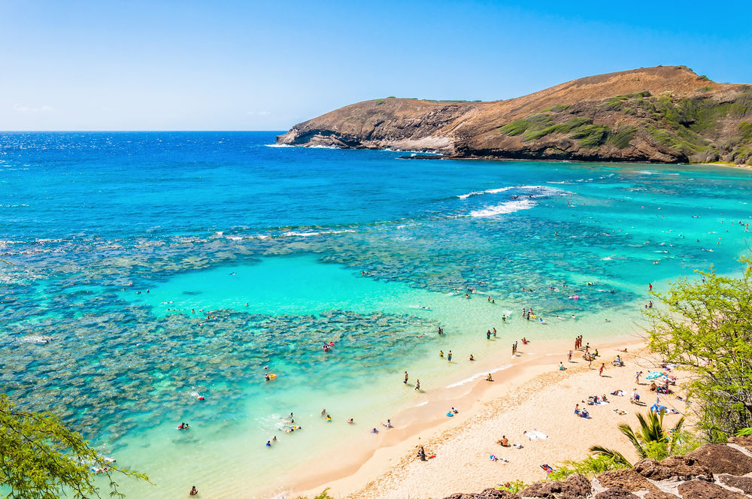
Hawaii
夏威夷
为了使得我们今天晚上的这个环境更加的轻松一点，我回忆起我曾经在1945年、46年的大学年代，经常我们喜欢玩儿“Hawaii guitar”，经常弹奏的Aloha 'Oe这个歌曲。在我祝酒之前，我去弹一曲Aloha 'Oe这个guitar，请州长夫人演唱！

